Slide 1
Forms of energy
Renewable and nonrenewable

Slide 2
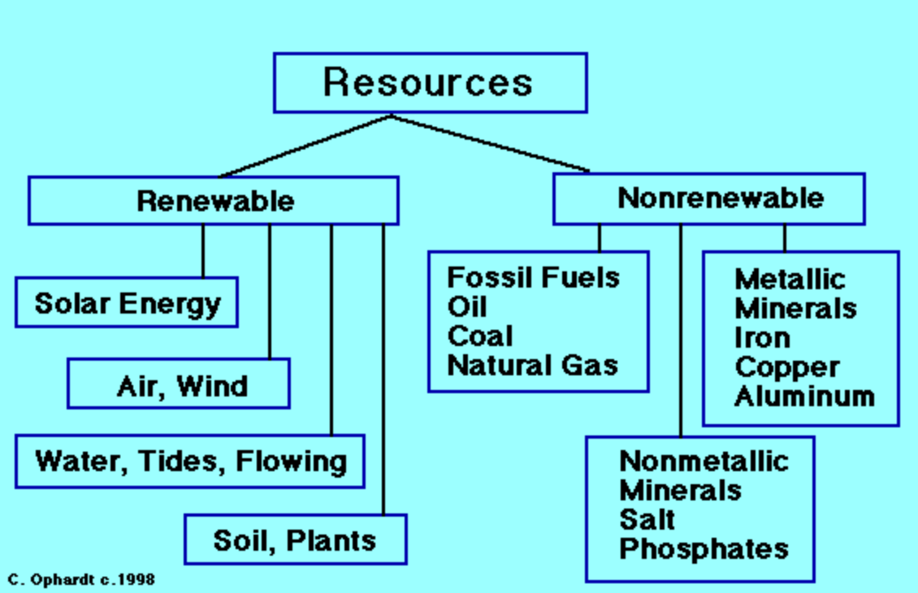
List renewable and non renewable resources
review
What is Missing?

Slide 3
inquiry questions
What gives us the energy to turn on a light / computer / oven?
How does the energy get into our homes?
How do natural resources give us energy?
Which resources give us the “best” energy? Explain Why.
Why do we even need to think about this and be aware of this issue?
Why do we even need to think about this and be aware of this issue?

Slide 4
How energy gets into our homes
https://www.youtube.com/watch?v=20Vb6hlLQSg&noredirect=1

Slide 5
Resources
Which resources are used for energy?
Where in Australia are these resources found?
Explain why it is critical that these resources be conserved for the future.
What alternatives could be used instead?

Slide 6
“Type a quote here.”
–Johnny Appleseed

