Slide 1
Chapter 1
Overview: the ancient world

Slide 2
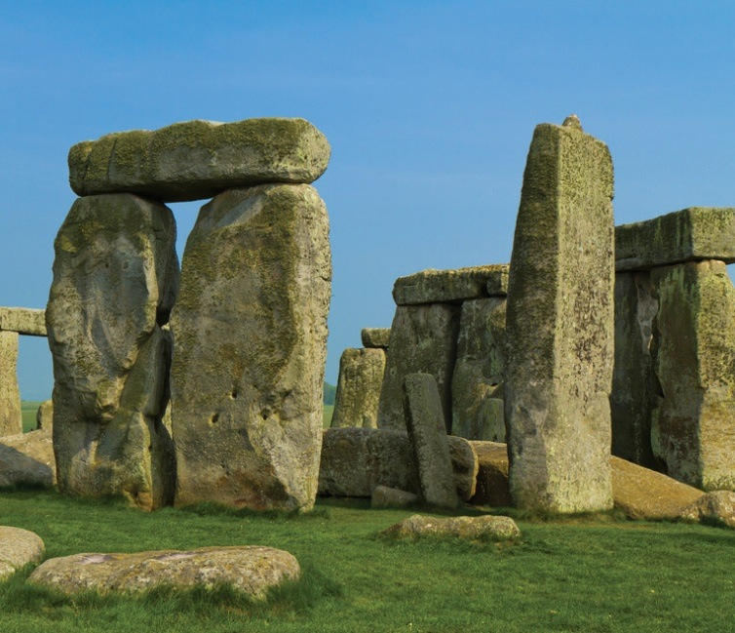
The evolution of early humans
The early ancestors of modern humans evolved in Africa approximately 4 million years ago.
Homo sapiens evolved between 400,000 BCE and 130,000 BCE.
Like modern humans, these early humans were migratory.
Notes:
Early humans first expanded their range across Africa, then after 100,000 BCE migrated into Europe and Asia, and then to Australia and the Americas.

Slide 3
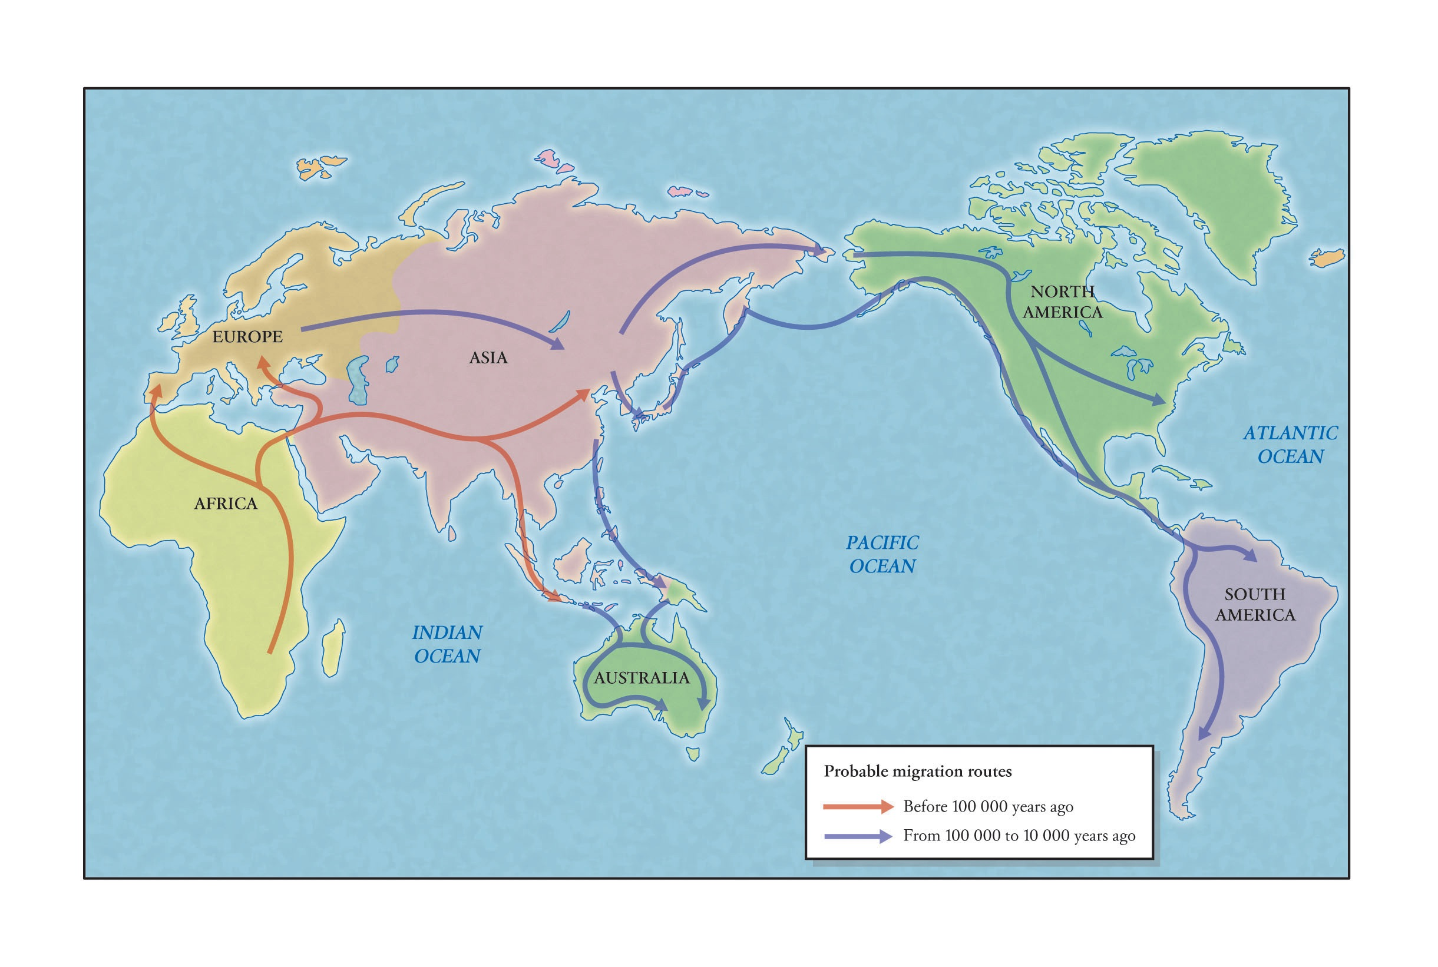
Global migration pattern of the early humans

Slide 4
The development of ancient civilisations
Some of the earliest civilisations formed in the fertile river valleys and flood plains of the Tigris, Euphrates and Nile Rivers – known as the Fertile Crescent.
Sites of Neolithic settlement have been discovered in China along the Yellow and Yangtze Rivers.
The Indus River valley in Pakistan was also another significant area of early human civilisation.

Slide 5
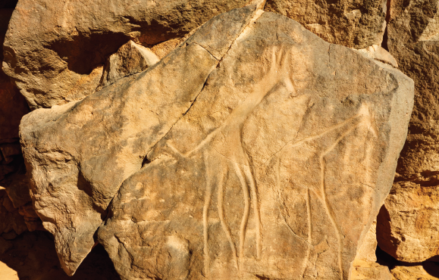
The key features of ancient civilisations
The development of agriculture and the increased reliability of food supplies allowed for population growth and the rise of cities.
The surplus of food and the wealth from it fostered the growth of trade.

Slide 6
The key features of ancient civilisations (cont.)
Social relations increasingly became divided by gender, which gave rise to patriarchal societies where males had greater power.
There was increased stratification of society, based on rank, occupation, wealth and power.
Early religions grew from a belief in the afterlife and the idea that a supernatural influence was behind animal fertility and crop production.

Slide 7
The key features of ancient civilisations (cont.)
A growing civil society required greater development of the rule of law, such as the code of Hammurabi, which contained 282 laws.
Specialist occupations such as priest, scribe and artist were created as societies diversified.
Writing was developed – the earliest form was the cuneiform script from ancient Sumer.

