Slide 1
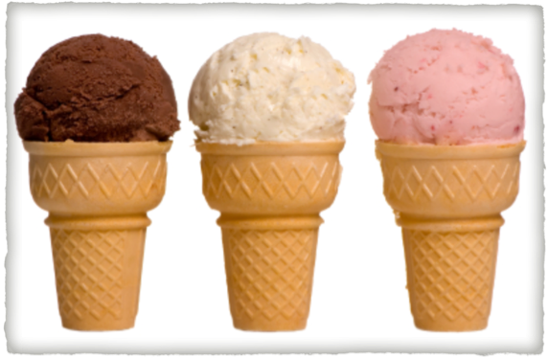
PROBABILITY AND STATISTICS: 1
More people prefer vanilla ice cream than any other flavour.
True or False?

Slide 2
YOUR TURN
Of the top 8 teams in the competition, the most popular AFL football team is Fremantle.
True or False?
Pizza is the favourite take-away food for Year 6/7 students.
True or False?
Inquiry Questions:
What information do you need?
Where will you go for the information?
How much information will you collect?
How will you record the information you collect?
How will you present your findings?

Slide 3
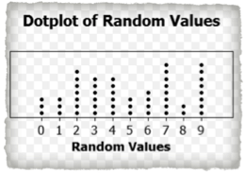
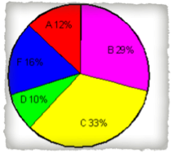
Task #1: Construct and conduct a survey to gather your information.
Task #2: Use a table to record and sort your information. Include the following:
choices (football teams, flavour)
predict how many of each number
total number of people surveyed (be sure to keep this to a number that can divide evenly into 100)
% of total surveyed
fraction of total surveyed
fraction into decimal
Task #3: Graph your results: dot-plot, bar or pie graph.
Task #4: Interpret the data - Were the results what you expected? Explain your reasoning.

Slide 4
TOTAL, PERCENT, FRACTIONS AND DECIMALS

Slide 5
PROBABILITY AND STATISTICS: 2
Inquiry Questions:
What information do you need?
Where will you go for the information?
How much information will you collect?
How will you record the information you collect?
How will you present your findings?
*If you were to roll a six-sided dice 50 times, 6 would be the most frequent number.
True or False?
**The most common number of children in a family is 2.
True or False?

Slide 6
MEAN, MEDIAN, MODE AND RANGE
Task #1: Construct and conduct a survey to gather your information.
Task #2: Use a table to record and sort your information. Include the following:
numbers (1,2,3,4,5,6)
predict how many of each number
total number of people surveyed (be sure to keep this to a number that can divide evenly into 100)
% of total surveyed
fraction of total surveyed
fraction into decimal
Task #3: Graph your results: dot-plot, bar or pie graph.
Task #4: Interpret the data - Were the results what you expected? Explain your reasoning.

Slide 7
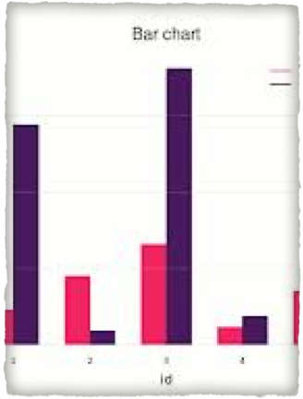
Review: charts,totals, percent, fractions, decimals and graphs.

Slide 8
PROBABILITY AND STATISTICS: 3
Most children in Yr 6/7 were born between the 17th and 25th of the month.
True or False?
Task #1: Construct and conduct a survey to gather your information. EXTENSION: How can you make this a more complex survey? (divide it into male and female)
Task #2: Use a table to record and sort your information. Include the following:
numbers (1,2,3,4,5,6)
predict how many of each number
total number of people surveyed (be sure to keep this to a number that can divide evenly into 100)
% of total surveyed
fraction of total surveyed
fraction into decimal
Task #3: Graph your results: dot-plot, bar or pie graph (double bar graph for male and female.
Task #4: Interpret the data - Were the results what you expected? Explain your reasoning.

